Slide 1
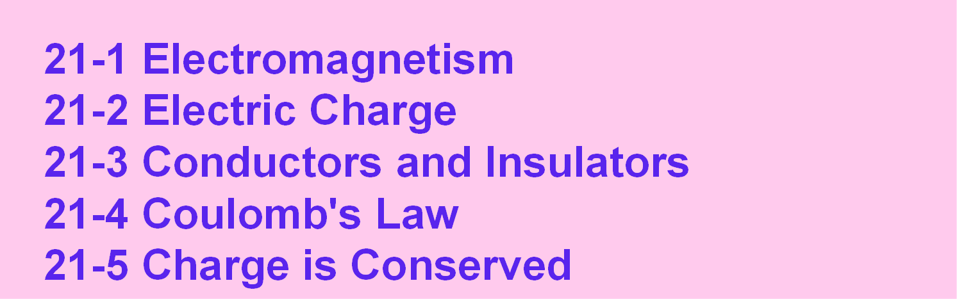
Chapter 21
Electric Charge
21-1 Electromagnetism
21-2 Electric Charge
21-3 Conductors and Insulators 21-4 Coulomb's Law
21-5 Charge is Conserved
Objective

Slide 2


21-1 Electromagnetism Electricity and magnetism
Electricity
Magnetism
Magnet
Iron
wire
Magnetic compass needle
A wire with no current does not influence the magnetic needle.
An electric current in the wire deflects the magnetic needle.
In 1882, Hans Oersted found connection between electricity and magnetism.
Electromagnetism

Slide 3
21-1 Electromagnetism Maxwell's equations
Michael Faraday did a lot of experiments to study electromagnetism.
Clark Maxwell, in the mid-19th century, put Faraday’s ideas into four equations which fully describe electromagnetism.
Electromagnetism equations (Maxwell’s equations)
□∫ E .d A
□∫ B .d A = 0
Gauss’ law for electricity
→ →
^{= q}enc^{ε}0
Gauss’ law for magnetism
→ →
Faraday’s law
□∫
→ →
E .d s =-
dΦ_{B}
dt
Ampere–Maxwell law
→ →
□∫ B .d s
=μ₀ε₀
dΦ_{E}
+μ₀
dt
^{i}enc
You do not need to know them now.

Slide 4
21-2 Electric Charge Electrically neutral objects
In any object, there is a huge number of positive and negative charges.
If the number of positive and negative charges are equal, we say that
the object is electrically neutral,
or
the object contains no net charge, or
positive and negative charges are balanced.

Slide 5
21-2 Electric Charge Electrically charged objects
If the number of positive and negative charges are not equal, we say that
the object is charged, or the object has a net charge, or
positive and negative charges are imbalanced.
We show only the net charge.

Slide 6
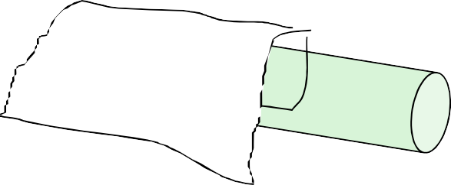
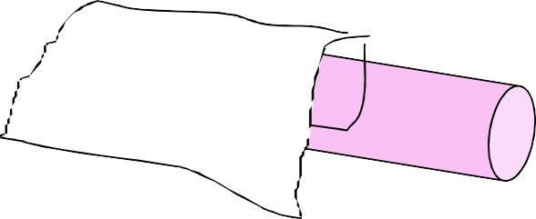
21-2 Electric Charge Charging by rubbing
Electrostatic charges are stationary or move very slowly.
Silk
Silk
Glass
Rubbing
Glass
Fur
Fur
Plastic
Rubbing
P lastic

Slide 7
21-2 Electric Charge
Direction of forces between two charges
→
F
→
F
Repulsion
→
F
→
F
Repulsion
→
F
→
F
Attraction

Slide 8
21-2 Electric Charge Electric charge is quantized
Electric charge is measured in Coulomb.
The smallest charge you can find is e = 1.6 X 10⁻¹⁹ C. All other charges are a multiple of this charge.
q = n e n = ± 1, ± 2, ± 3, …
q = +12 e or -60 e q = +3.5 e or -5.1 e
Possible Not possible
Charge cannot have any value. it has discrete values. Charge is quantized.
e is called the elementary charge.
We do not feel this discreetness in the charge because we deal with very huge number of elementary charges.

Slide 9
21-3 Conductors and Insulators
Charge of proton, neutron, and electron
All matters are made of protons, neutrons, and electrons.
p
Proton is very heavy. Proton has a charge of +e.
n
neutron is very heavy. neutron has no charge.
-e
Electron is very light. Electron has a charge of –e.
Mass of proton
= 1.67 × 10⁻²⁷ kg.
≈ mass of neutron.
≈ 1000 mass of electron.

Slide 10
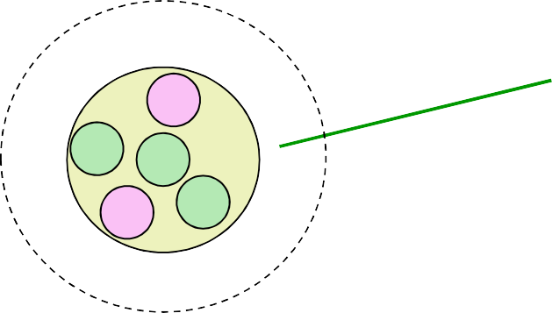
21-3 Conductors and Insulators
Outermost electrons in conductors and insulators
Atoms are electrically neutral.
-e
p n
nucleus
Atom
n
p
n
-e
For conductors, outermost electrons are loosely held by nucleus.
For Insulators, outermost electrons are tightly held by nucleus.
An atom becomes
a positive ion when it loses electrons, and
a negative ion when it gains extra electrons.

Slide 11
21-3 Conductors and Insulators Electrons in conductors and insulators
Electrons can move freely
Ions are fixed (solid) or move very slowly (liquid)
Electrons held to ions and cannot move freely
-e
-e
-e
-e
-e
-e
-e
-e
-e
-e
-e
-e
Conductors
Insulators
metals human body tap water
glass plastic pure water

Slide 12
21-3 Conductors and Insulators Checkpoint 1
Neutral conductor C
Neutral Conductor C
Insulator A
Insulator D
Insulator B
Insulator B
Insulator A
Insulator D
Insulator A
Insulator D
For the remaining pairs, do the plates repel or attract each other?
Solution

Slide 13
21-4 Coulomb's Law Formula - Coulomb's law
q₁
q₂
→
F
r
Charged particle (point
Distance
Charged particle with charge of magnitude |q₂|
charge) with charge of magnitude |q₁|
_{F=k} |q₁||q₂|
Magnitude of the electrostatic force of charged particle 1 on charged
particle 2
_{r}2
constant
Coulomb's Law
k= 8.99×10⁹ N m² /C²
1
k =
4πε₀
permittivity constant
-12 2 2
ε₀ = 8.85 × 10 C /N m

Slide 14
21-4 Coulomb's Law
Forms of electrostatic force and gravitational force
Electrostatic force
→
Gravitational force
→
F
F
q₁ q₂
m₁ m₂
_{F=k} |q₁||q₂|
m₂
F=G ^{m1}
_{r}2
_{r}2
The electrostatic force has the same form as the gravitational force.

Slide 15
21-4 Coulomb's Law A third-law force pair
→
→
F
F
q₁ q₂
Each particle exerts a force of the same magnitude on the other.
The two forces forms a third-law force pair.

Slide 16
21-4 Coulomb's Law Notation
→
F54
On particle 5
→
F
q₁
Because of (due to) particle 4
→
F
q₂
q₁
q₂
→
F12
→
F21
Force on charged particle 1 because of charged particle 2
Force on charged particle 2 because of charged particle 1
^{F}12 ^{= F}21

Slide 17
21-4 Coulomb's Law Principle of superposition
q₂
q₃
q
4
→
F13
q₁
→
→
F12
F1,net
→
F14
→
F1,net
→ → →
= F12 + F13 + F14
Principle of superposition: the net force acting on any particle is the
vector sum of the forces acting on this particle due to individual particles

Slide 18
21-4 Coulomb's Law
A shell of uniform charge
Point charge
A shell of uniform
→
F1,shell
q₁
charge q₂
→
→
= F1,point2
F1,shell
Same
Point charge
Point charge
→
F1,point2
q₂ q₁
A shell of uniform charge
attracts or repels a charged particle that is outside the shell as if all the shell’s charge were concentrated at its center.

Slide 19
21-4 Coulomb's Law
Point charge inside a shell of uniform charge
Point charge inside the shell
A shell of uniform charge q₂
q₁
No force on q₁ from the shell
If a charged particle is located inside a shell of uniform charge, there is no net electrostatic force on the particle from the shell.

Slide 20
21-4 Coulomb's Law
Excess charge on a spherical conductor
Excess charge spreads uniformly to maximize the distances between all pairs of electrons.
Excess charge
Spherical shell made of conducting material
If excess charge is placed on a spherical shell that is made of a conducting material, the excess charge spreads uniformly over the surface.

Slide 21
21-4 Coulomb's Law
Example 1
q₁=1.6 х 10⁻¹⁹ C
q₁
q₂
q =3.2 х 10⁻¹⁹ C
x
2
→
F12
R=0.02 m
R
→
What is the electrostatic force F12 on particle 1 from particle 2?
Solution
_{=k} |q₁||q₂|
F
_{R}2
12
(1.6x10⁻¹⁹ C)(3.2x10⁻¹⁹ C)
F =(8.99x10⁹ N m² /C² )
=1.15x10⁻²⁴ N
12
(0.02 m)²
→
F12
= - (1.15x10⁻²⁴ N)^{ˆ}i

Slide 22
21-4 Coulomb's Law
Example 2
q₁=1.6 х 10⁻¹⁹ C q₂=3.2 х 10⁻¹⁹ C R=0.02 m
→
F12
q
→
F13
q
q
1
3
2
x
→
F12
-24
ˆ
¾ R
= - (1.15x10 N)i
q₃= - 3.2 х 10⁻¹⁹ C
→
What is the electrostatic force F_{1,net} on particle 1 due to particles 2 and 3?
Solution
→
F1,net =
→ →
F12 + F13
|q₁||q₃|
F = k
13
(3R/4)²
(1.6x10⁻¹⁹ C)(3.2x10⁻¹⁹ C)
F =(8.99x10⁹
N m² /C² )
3
4
=2.05x10⁻²⁴ N
13
(
0.02 m)
2
→
F13
-24
ˆ
= (2.05x10 N)i
→ → →
F1,net F12 + F13
=
= - (1.15x10⁻²⁴ N)^{ˆ}i + (2.05x10⁻²⁴ N)^{ˆ}i = (9.00x10⁻²⁵ N)^{ˆ}i

Slide 23
21-4 Coulomb's Law
Example 3
q₁=1.6 х 10⁻¹⁹ C q₂=3.2 х 10⁻¹⁹ C
R=0.02 m
y
q₄
q₄= - 3.2 х 10⁻¹⁹ C
¾ R
→
→
F12 = - (1.15x10 N)i
F14
-24
ˆ
q₂
q
→
1
θ=60⁰
What is the electrostatic force F_{1,net} on particle 1 due to particles 2 and 4 ?
x
→
F12
R
Solution
→
F1,net =
→ →
F12 + F14
y
→
F14
F = 2.05x10⁻²⁴ N
14
F₁₄sin θ
→
F14
→
F14
= F cos θ ^{ˆ}i + F sin θ^{ˆ}j
14 14
-24
ˆ ˆ
θ
x
-24
= (1.025x10 N) i + (1.775x10 N) j
F₁₄cos θ
→ → →
F1,net F12 + F14
= - (1.15x10⁻²⁴ N)^{ˆ}i + (1.025x10⁻²⁴ N) ^{ˆ}i + (1.775x10⁻²⁴ N) ^{ˆ}j
= (- 1.55x10⁻²⁵ N) ^{ˆ}i + (1.775x10⁻²⁴ N) ^{ˆ}j
=

Slide 24
21-4 Coulomb's Law
Example 4
y
→
F1,net = (- 1.55x10 N) i + (1.775x10 N) j
-25
ˆ ˆ
→
-24
F1,net
→
F14
Express this force in terms of the magnitude of the force and the angle between the force and the positive x-axis.
φ
→
F12
x
Solution
_{F}2
+ F²
= 1.78x10⁻²⁴ N
-b
^{F}1,net ⁼
1,net,x
1,net,y
tan γ =
y
a b
φ= tan⁻¹ (
^{F}1,net,y
tan φ =
) = - 86.0⁰ +180⁰ = 94.0⁰
- a
^{F}1,net,x
b
φ
a a
b
tan γ = tan φ
Using a calculator. Wrong answer.
The vector is in the second quadrant. When you find an angle from an inverse trigonometric function, check the validity of your answer!
x
γ =−86⁰

Slide 25
21-4 Coulomb's Law
Checkpoint 3
p p
Rank the arrangement according to the magnitude of the net force on the electron due to the protons.
In the last arrangement, is
-e
d₁
1
d₂
d₂
d₁
p
-e
p
the angle between the force on the electron and the x-axis less than or more than 45⁰?
3
d₂ < d₁
d₁
-e
p
d₂
2
p
Solution
More than 45⁰.

Slide 26
21-4 Coulomb's Law
Example 5
q₁= +8 e
q₂= -2 e
At what point (not infinity) can a proton be placed so that it’s in equilibrium?
x
L
^{Solution} Magnitude of the
force on the proton F_{p1}=k
due to charge 1
q₁= +8 e
e(8e)
Magnitude of the
force on the proton F_{p2} =k
due to charge 2
q₂= -2 e Not good.
Both in the same direction
e(2e)
_{r}2
_{r}2
p1
p2
p
x
q₁= +8 e
Not good. Force from q₁ always greater
q₂= -2 e
p
x
than force from q₂
q₂= -2 e
Possible
q₁= +8 e
p
x

Slide 27
21-4 Coulomb's Law
Example 5
Solution
q₁= +8 e
q₂= -2 e
Possible
p
x
L
x
^{F}p1^{=F}p2
x-L
_{k} e(8e) _{=k} e(2e)
_{x}2
8
(x- L)²
2
_{x}2
=
(x- L)²
8(x- L)² =2x²
4(x- L)² =x²
2(x- L)=x
x=2L

Slide 28
21-4 Coulomb's Law
Example 6
Is the equilibrium stable or unstable?
q₁= +8 e
q₂= -2 e
p
x
L
L
Solution
If the equilibrium is stable, the the proton must go back to its equilibrium position
when it is moved slightly from it.
At equilibrium
→
F =(k
e(8e) e(2e)
ˆ
- k
_{L}2
) i = 0
(2L)²
If you push the proton slightly to the right by dx,
e(8e) e(2e)
2e²
1
1
→
F = (k - k
ˆ
ˆ ˆ
)i = k
(
dx
-
dx
)i > 0 i
2 2
L
2
₎2
₎2
(2L+dx) (L+dx)
(1+
(1+
the proton moves to the right.
2L
L
If you push the proton slightly to the left by dx,
→
F = (k
e(8e) e(2e) 2e²
1
1
ˆ
- k ) i = k (
dx
-
dx
)^{ˆ}i < 0^{ˆ}i
2 2 2
₎2
₎2
(2L-dx) (L- dx) L
(1-
(1-
the proton moves to the left.
2L
L
Equilibrium is not stable.

Slide 29
21-4 Coulomb's Law
Example 7
Two identical electrically isolated conducting spheres A and B
A q = 0 A
A
Thin conducting wire
B +Q B B
a
What is the magnitude of the electrostatic force between sphere A and B after removing the conducting wire? Ignore induced charges.
Solution
Because the spheres and wire are conductors, electrons move throught them until the charge on the two spheres are the same.
A +Q/2
F_{AB} =k
(Q/2)(Q/2)
_{a}2
B +Q/2

Slide 30
21-4 Coulomb's Law
Example 8
A +Q/2
A
A
a
B
+Q/2
B
conducting wire
B
Ground
What is the magnitude of the electrostatic force between sphere A and B after removing the conducting wire? Ignore induced charges.
Solution
The ground is a huge supply of electrons. Electrons will move from the ground to sphere B until sphere B is neutralized. Thus it contains no net charge.
A +Q/2
F = 0
B q = 0
AB

Slide 31
21-4 Coulomb's Law
Checkpoint 4
Two identical (same size) electrically isolated conducting spheres A and B
Solution
A q_{A} = -50e A
q_{A} = -15e
A
B
B q_{B} =+ 20e
B q_{B} = -15e
Touching
If the spheres touch, what is the resulting charge on sphere A?

